Slide 1
RURAL DEVELOPMENT
Presented By-
Aishwarya Sarna

Slide 2
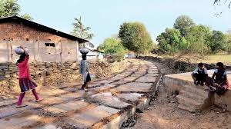
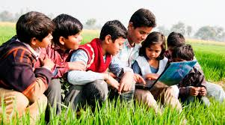
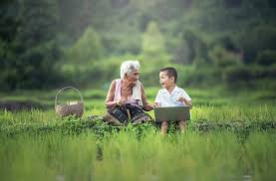
What is Rural Development?
Why Rural Development?
How is Rural Development possible?

Slide 3
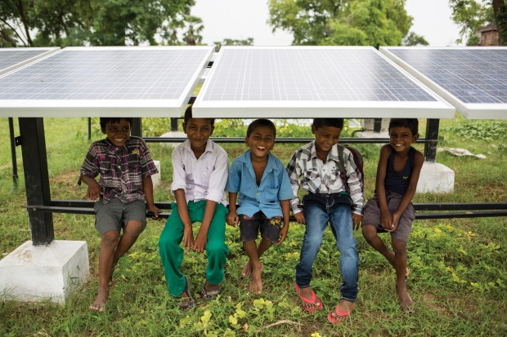
DHARNAI, BIHAR

Slide 4
THANK YOU

